Slide 1

의료정보학시스템
Device on FHIR 3
Dept. of Computer Science & Engineering
College of IT
Kyungpook National University
2017.11.20.

Slide 2
Resources
DeviceComponent
<MDS>
source
Device
parent
source
DeviceComponent
<VMD>
source
source
parent
DeviceComponent
<CHAN>
parent
DeviceMetric
device
Observation
Patient
subject

Slide 3
Device Resource
Device
<Device xmlns="http://hl7.org/fhir">
<identifier>
<system value="http://acme.org/devices/serialnumber"/>
<value value="1111"/>
</identifier>
<type>
<coding>
<system value=" urn:iso:std:iso:11073:10101"/>
<code value="528456"/>
<display value="MDC_DEV_SPEC_PROFILE_AI_MED_MINDER"/>
</coding> </type>
<status value="available"/>
<manufacturer value="Healthall, Inc"/> 회사명
<model value="Cabinet0009"/> device일련번호/이름
<udi value="00:EA:21:02:03:56"/> 블루투스 주소
<location>
<reference value="Location/10811"/> Location
</location>
<patient>
<reference value="Patient/10810"/> Patient
</patient>
<contact>
<value value="0123456789"/>
<use value="mobile"/>
</contact>
</Device>
http://wiki.hl7.org/index.php?title=DoF_2017-JAN_IHE_NA_CAT_Cleveland
http://hl7.org/fhir/device.html

Slide 4
Resource Analysis
(Blood glucose)
<Observation xmlns="http://hl7.org/fhir">
<id value="f001"/>
<identifier>
<use value="official"/>
<system value="http://www.bmc.nl/zorgportal/identifiers/observations"/>
<value value="6323"/>
</identifier>
<status value="final"/>
<code>
<coding>
<system value="http://loinc.org"/>
<code value="15074-8"/>
<display value="Glucose [Moles/volume] in Blood"/>
</coding>
</code>
<subject>
<reference value="Patient/f001"/>
<display value="P. van de Heuvel"/>
</subject>
<effectivePeriod>
<start value="2013-04-02T09:30:10+01:00"/>
</effectivePeriod>
<issued value="2013-04-03T15:30:10+01:00"/>
<performer>
<reference value="Practitioner/f005"/>
<display value="A. Langeveld"/>
</performer>
<valueQuantity>
<value value="6.3"/>
<unit value="mmol/l"/>
<system value="http://unitsofmeasure.org"/>
<code value="mmol/L"/>
</valueQuantity>
</Observation>
식별자
측정 정보 Code
측정 대상(환자)
측정 일자
측정자(의사 or 간호사)
측정 값

Slide 5
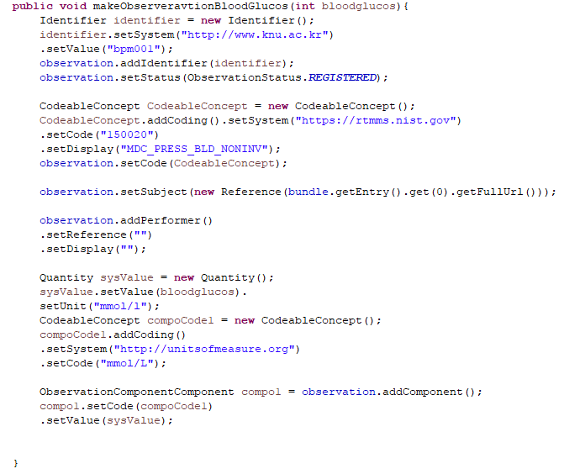
Source code

Slide 6
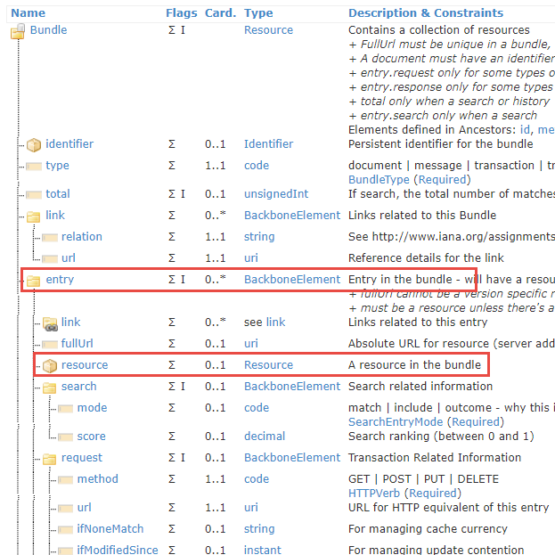
Bundle Resource
Bundle resource? - A container for a collection of resources.
Why? - Resources are bundled and sent to the server.

Slide 7
Bundle Resource
<type>
<coding>
<system value="urn:iso:std:iso:11073:10101"/>
<code value="4172"/>
<display value="MDC_DEV_ANALY_PRESS_BLD"/>
</coding>
</type>
<lotNumber value="20150301001"/>
<manufacturer value="VANILLA"/>
<manufactureDate value="3885-02-01T00:00:00+09:00"/>
<model value="BPM01"/>
<patient>
<reference value="p1"/>
</patient>
</Device>
</resource>
<request>
<method value="POST"/>
<url value="device"/>
</request>
</entry>
<entry>
<fullUrl value="urn:uuid:4fd161f0-52b7-4389-a013-398694697d9e"/>
<resource>
<DeviceComponent xmlns="http://hl7.org/fhir">
<id value="1"/>
<identifier>
<system value="http:www.vanila.co.kr"/>
<value value="mds001"/>
</identifier>
<type>
<coding>
<system value="urn:iso:std:iso:11073:10101"/>
<code value="4173"/>
<display value="MDC_DEV_ANALY_PRESS_BLD_MDS"/>
</coding>
</type>
<lastSystemChange value="3885-02-01T00:00:00.000+09:00"/>
<source>
<reference value="urn:uuid:8c30dc32-32ce-4369-b895-34bc3ecde057"/>
</source>
</DeviceComponent>
</resource>
<request>
<method value="POST"/>
<url value="DeviceComponent"/>
</request>
</entry>
<entry>
<fullUrl value="urn:uuid:26705150-01cb-4393-b3f6-e7b931409bc7"/>
<resource>
<Observation xmlns="http://hl7.org/fhir">
<identifier>
<system value="http://www.knu.ac.kr"/>
<value value="bpm001"/>
</identifier>
<status value="registered"/>
<code>
<coding>
<system value="https://rtmms.nist.gov"/>
<code value="150020"/>
<display value="MDC_PRESS_BLD_NONINV"/>
</coding>
</code>
<subject>
<reference value="urn:uuid:c012d081-c2dc-41df-8293-5ab2354ca3af"/>
</subject>
<bodySite>
<coding>
<system value="http://snomed.info/sct"/>
<code value="368209003"/>
</coding>
</bodySite>
<device>
<reference value="urn:uuid:8c30dc32-32ce-4369-b895-34bc3ecde057"/>
</device>
<component>
<code>
<coding>
<system value="https://rtmms.nist.gov"/>
<code value="150021"/>
<display value="MDC_PRESS_BLD_NONINV_SYS"/>
</coding>
</code>
<valueQuantity>
<value value="70"/>
<unit value="mm[Hg]"/>
</valueQuantity>
</component>
<component>
<code>
<coding>
<system value="https://rtmms.nist.gov"/>
<code value="150022"/>
<display value="MDC_PRESS_BLD_NONINV_DIA"/>
</coding>
</code>
<valueQuantity>
<value value="130"/>
<unit value="mm[Hg]"/>
</valueQuantity>
</component>
<component>
<code>
<coding>
<system value="https://rtmms.nist.gov"/>
<code value="150023"/>
<display value="MDC_PRESS_BLD_NONINV_MEAN"/>
</coding>
</code>
<valueQuantity>
<value value="100"/>
<unit value="mm[Hg]"/>
</valueQuantity>
</component>
</Observation>
</resource>
<request>
<method value="POST"/>
<url value="Observation"/>
</request>
</entry>
</Bundle>
<Bundle xmlns="http://hl7.org/fhir">
<type value="transaction"/>
<entry>
<fullUrl value="urn:uuid:c012d081-c2dc-41df-8293-5ab2354ca3af"/>
<resource>
<Patient xmlns="http://hl7.org/fhir">
<identifier>
<system value="http:www.knu.ac.kr"/>
<value value="KNU003"/>
</identifier>
<active value="true"/>
<name>
<use value="usual"/>
<family value="홍"/>
<given value="길동"/>
</name>
<telecom>
<system value="phone"/>
<value value="010-0000-0000"/>
<use value="home"/>
</telecom>
<gender value="male"/>
<birthDate value="1999-03-01"/>
</Patient>
</resource>
<request>
<method value="POST"/>
<url value="Patient"/>
</request>
</entry>
<entry>
<fullUrl value="urn:uuid:8c30dc32-32ce-4369-b895-34bc3ecde057"/>
<resource>
<Device xmlns="http://hl7.org/fhir">
<id value="1"/>
<identifier>
<system value="http:www.vanila.co.kr"/>
<value value="device001"/>
</identifier>
<status value="active"/>
Entry안에 Resource 포함

Slide 8
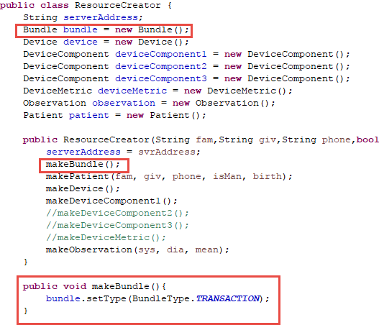
Make Bundle Resource

Slide 9
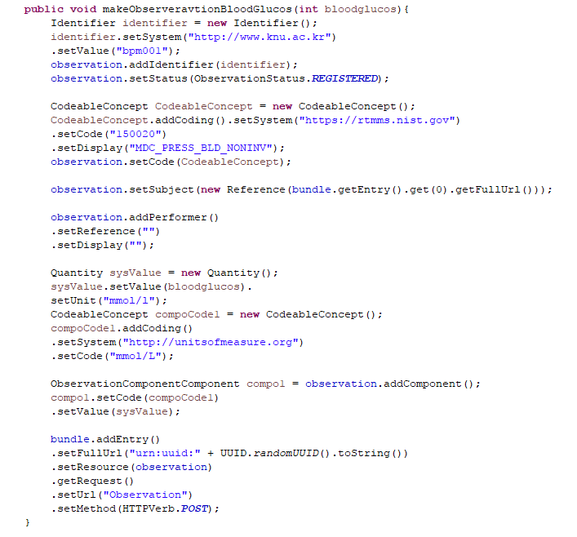
Add Resource

Slide 10
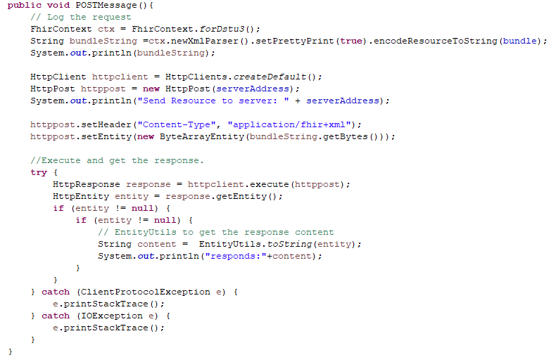
Send Resource(HTTP POST)

Slide 11
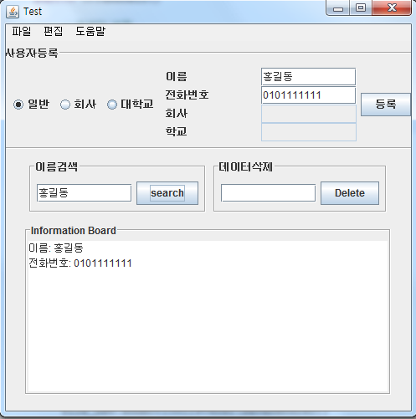
JAVA GUI
Graphical User Interface

Slide 12
AWT & Swing
AWT (Abstract Window Toolkit) : 윈도우에 있는 도구를 사용한다
1. 플랫폼(운영체제)에 종속적인 컴포넌트이다.
2. 중량의 컴포넌트 : 시스템 자원을 끌어와서 사용하기 때문 (윈도우를 거쳐서 사용)
3. 단일 프레임 : 컴포넌트가 적재되는 패널이 하나만 존재
Swing(Java Foundation Class Library)
1. 플랫폼에 독립적인 컴포넌트이다. : 시스템에 독립적으로 프레임 구축
2. 경량의 컴포넌트
3. 다중 프레임(Multi frame) : 컴포넌트를 표시하는 패널이 계층별로 여러 개 존재 한다.
Frame -> Root Panel -> Layer Panel -> Content Panel -> Glass Panel

Slide 13
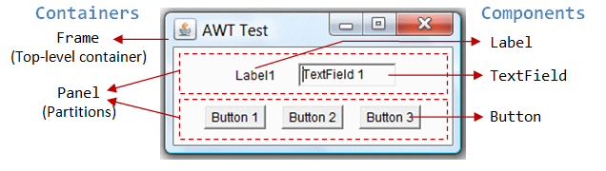
Containers and Components

Slide 14
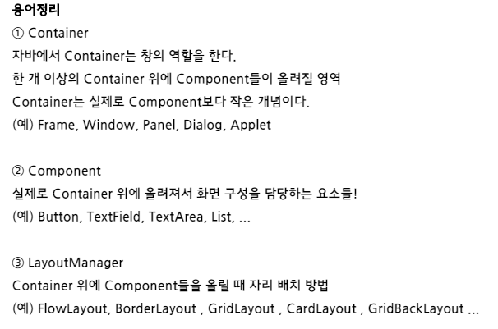
Containers and Components

Slide 15
Class
JFrame – A frame is an instance of JFrame. Frame is a window that can have title, border, menu, buttons, text fields and several other components. A Swing application must have a frame to have the components added to it.
JPanel – A panel is an instance of JPanel. A frame can have more than one panels and each panel can have several components. You can also call them parts of Frame. Panels are useful for grouping components and placing them to appropriate locations in a frame.
JLabel – A label is an instance of JLabel class. A label is unselectable text and images. If you want to display a string or an image on a frame, you can do so by using labels. In the above example we wanted to display texts “User” & “Password” just before the text fields , we did this by creating and adding labels to the appropriate positions.
JTextField – Used for capturing user inputs, these are the text boxes where user enters the data.
JButton – A button is an instance of JButton class. In the above example we have a button “Login”.

Slide 16
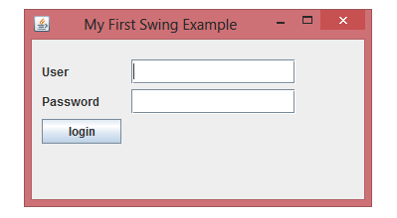
Simple example 1
Make this

Slide 17
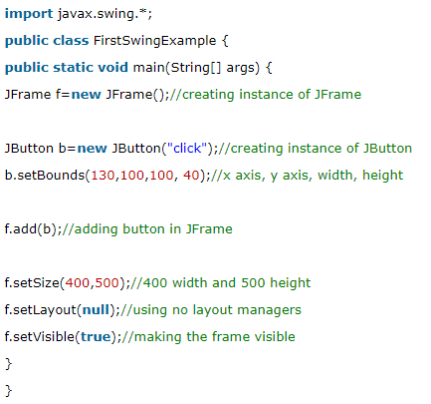
Example code

Slide 18
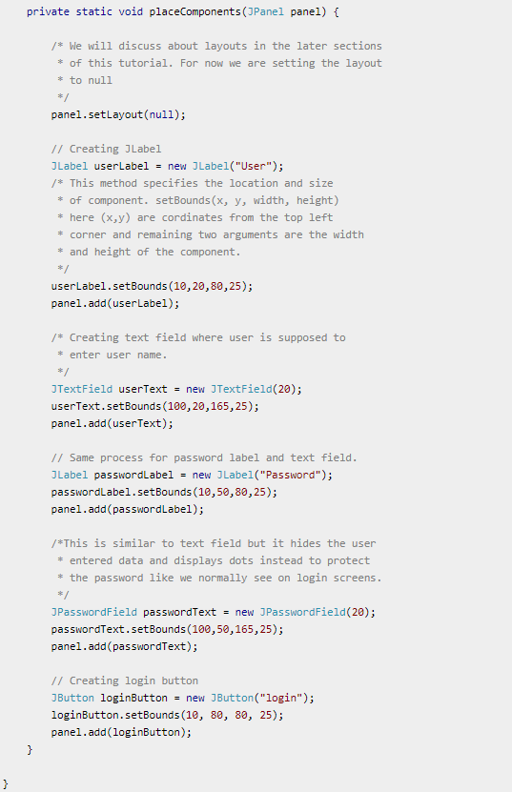
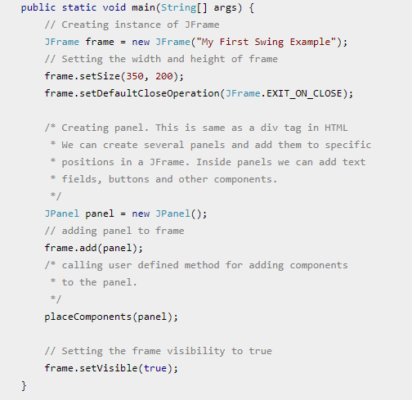
Example code

Slide 19
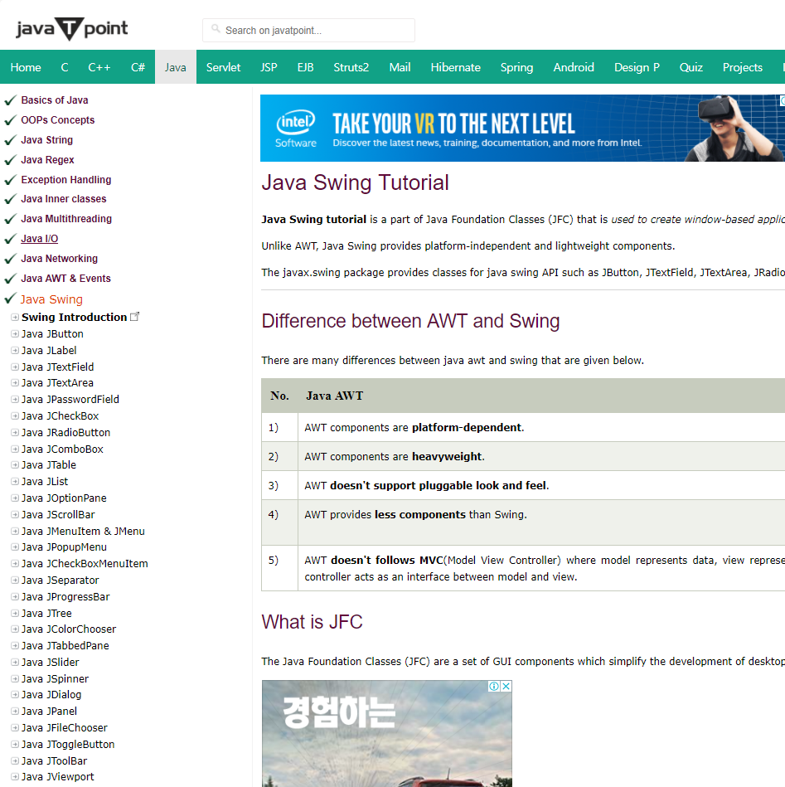
Reference site
https://www.javatpoint.com/java-swing

Slide 20
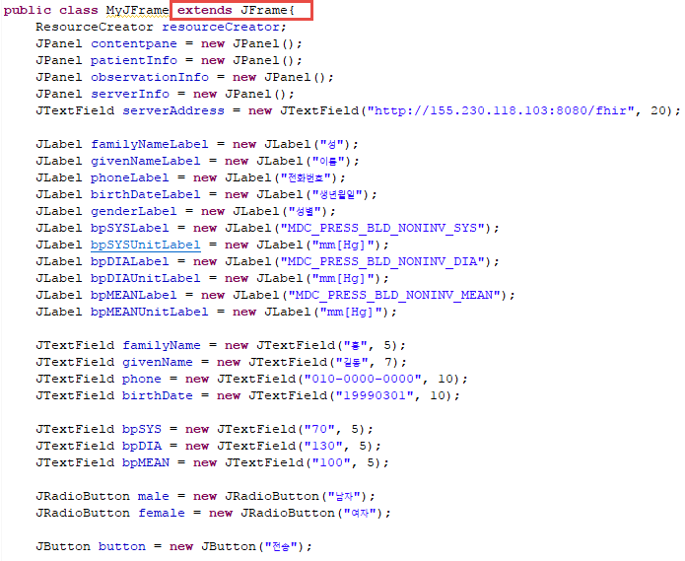
Blood pressure example
Field
variable

Slide 21
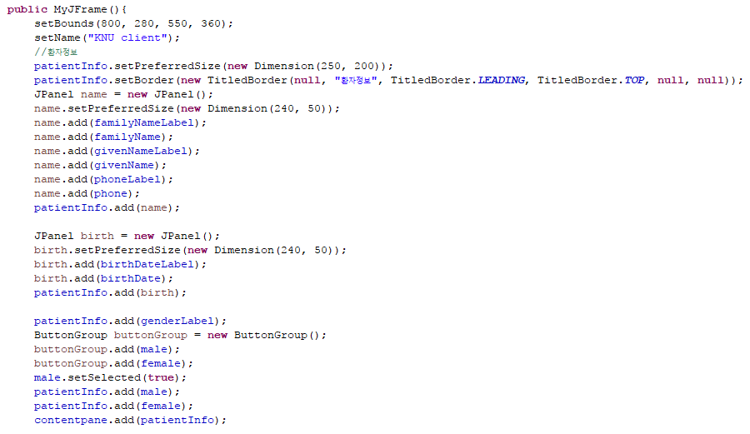
Blood pressure example
Frame setting 1

Slide 22
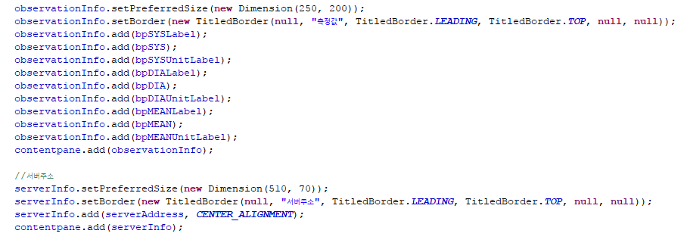
Blood pressure example
Frame setting 2

Slide 23
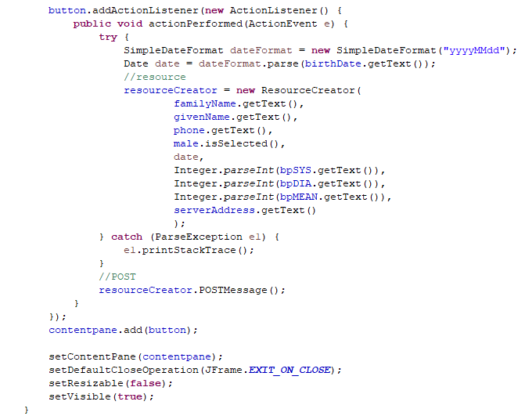
Blood pressure example
Frame setting 3(add actionListener)

Slide 24
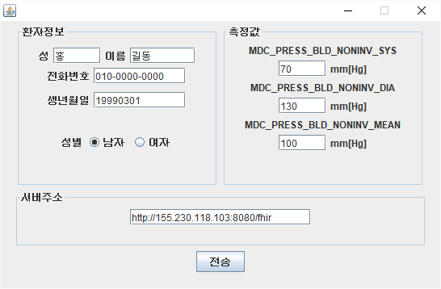
Result

Slide 25
Assignment
1. Make Observation resource that contains Blood glucose data in java.(source code, screenshot)
2. Make DoF Client that can measure Blood glucos by using JAVA GUI(Jbotton, Jpanel, … ) Like this->(source code)
Submission Deadline: November 26, 2017 11:59 PM

Slide 26


